Slide 1
Bengali Sentiment Analysis with Deep Learning Models
Group No - 14
Saurav Das - 20101100
Kaushik Roy - 20101185
Md. Sifat Kamal - 20101231
Md Mahfujul Haque - 20101445
ST - Mehnaz Ara Fazal
RA - Md Sabbir Hossain
‹#›

Slide 2
Table of Contents
Introduction
Literature Review
Proposed Model
Model Architecture
Dataset
Evaluation
Future Scope of Improvement
Conclusion

Slide 3
Introduction
Sentiment Analysis is a process of determining the sentiment of a text
Many industries or businesses can use this technique for expanding their businesses
Can be use text data like Emails, Social Media Comments, and Customer Review etc.
Worked with the Bengali Sentiment Analysis with Deep Learning Models
Able to determine the author's emotion towards the provided Bengali text automatically

Slide 4
Literature Review
From paper [1], we have learned about the power and versatility of BERT in natural language processing tasks, particularly in sentiment analysis, and the methodology for utilizing pre-trained BERT models for various NLP tasks through Transfer Learning, fine-tuning, and evaluation on specific datasets.
The paper [2] has demonstrated the potential of cross-lingual sentiment analysis in low-resource languages, particularly Bengali, and highlighted the effectiveness of supervised machine learning classifiers in classifying sentiment in machine-translated Bengali and English corpus.
The paper [3] presents a novel approach to sentiment analysis using Speech Emotion Recognition and Multilayer Perceptron Classifier, which holds great potential for improving human-computer interaction and advancing the field of artificial intelligence.
The paper [4] demonstrates the effectiveness of utilizing informal word vectors and the attention model in improving the prediction accuracy of deep neural networks for sentiment analysis of Persian texts.

Slide 5
Proposed Model
Constructed Bengali Sentiment Analysis with Deep Learning models
Used 3 deep learning models such as:
BERT
LSTM
MLP Classifier
Used a Bengali Sentiment Dataset that includes sentiments of positive/negative according to the sentences

Slide 6
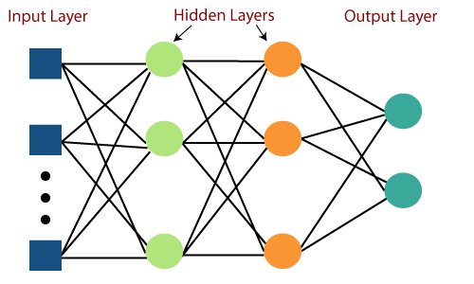
Model Architecture
MLP

Slide 7
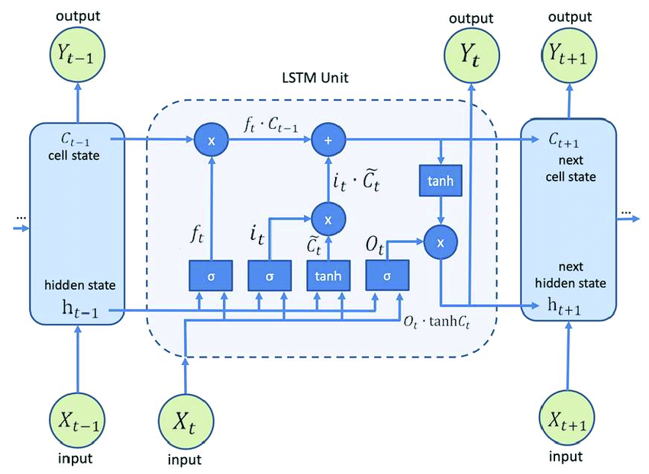
Model Architecture (Continued)
LSTM

Slide 8
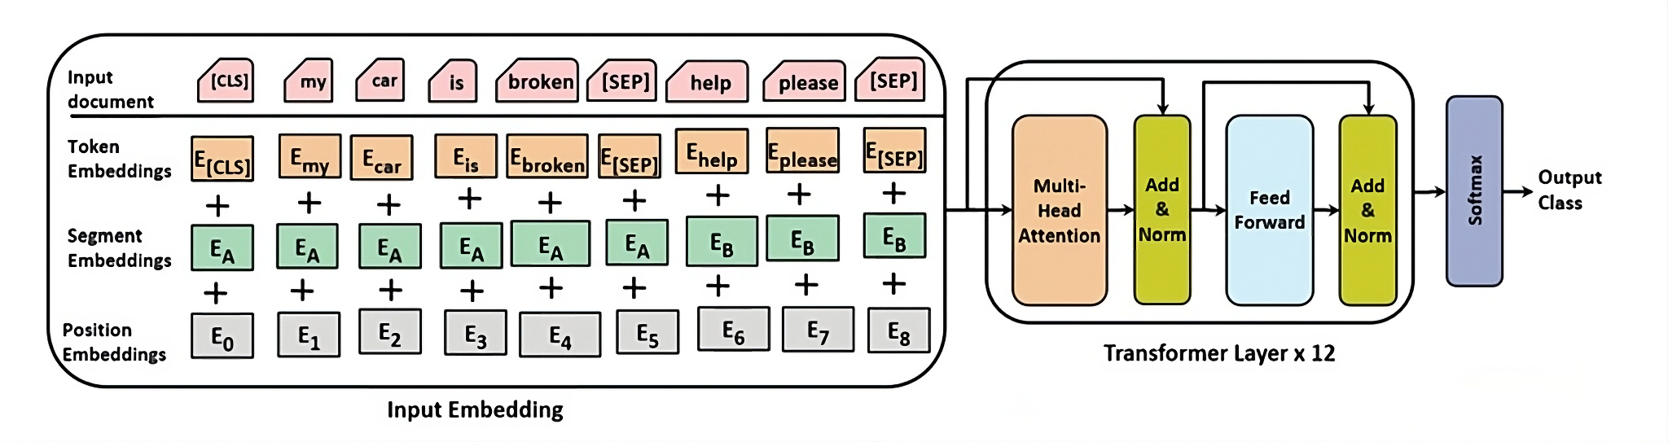
Model Architecture (Continued)
BERT

Slide 9
Dataset
3307 Negative reviews
8500 Positive reviews
Collected and manually annotated from Youtube Bengali drama
Has No Null Value
Made by Sazzed, Salim

Slide 10
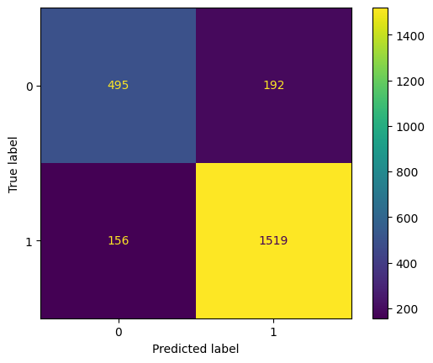
Evaluation (MLP Classifier)
 | Precision | Recall | F1-Score
Negative | 0.76 | 0.72 | 0.74
Positive | 0.83 | 0.91 | 0.90
Macro Avg. | 0.82 | 0.81 | 0.82
Weighted Avg. | 0.85 | 0.85 | 0.85

Slide 11
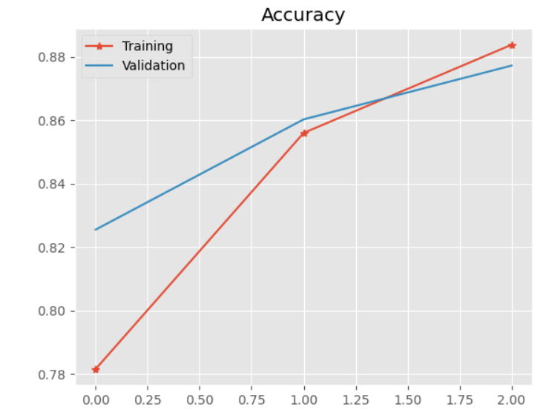
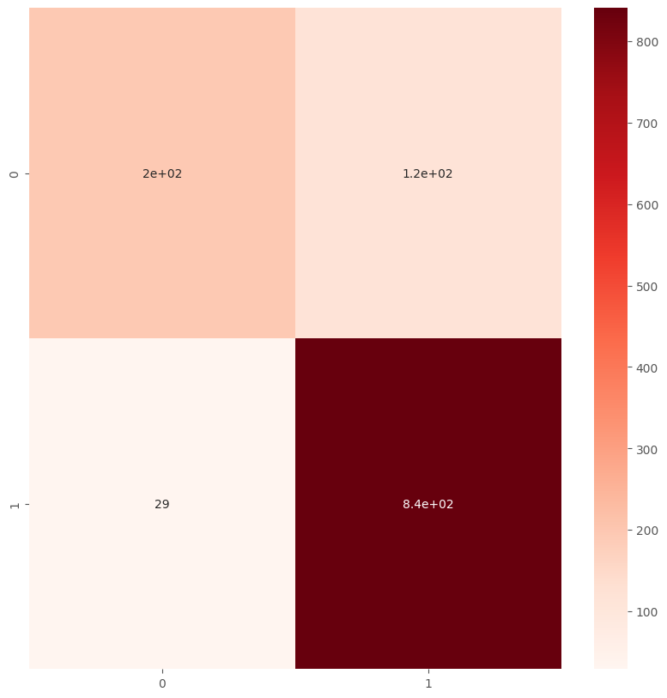
Evaluation (BERT)

Slide 12
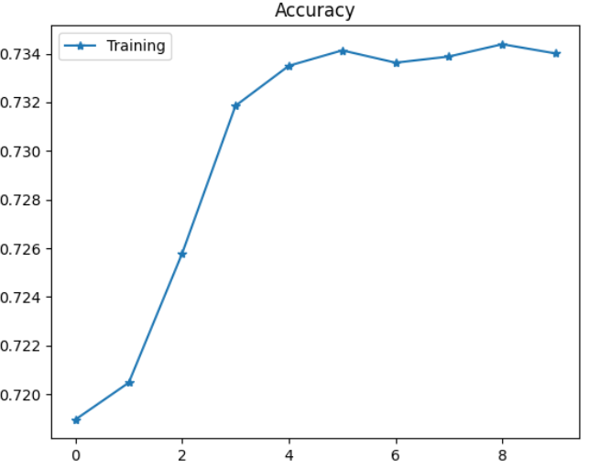
Evaluation (LSTM)
 | Precision | Recall | F1-Score
Negative | 0.52 | 0.02 | 0.04
Positive | 0.71 | 0.99 | 0.83
Micro Avg. | 0.71 | 0.71 | 0.71
Macro Avg. | 0.61 | 0.51 | 0.44
Weighted Avg. | 0.66 | 0.71 | 0.60
Sample Avg. | 0.71 | 0.71 | 0.71

Slide 13
Future scope of improvement
Limitation
Only positive and negative sentiment added
Uneven positive and negative dataset
Couldn’t remove Stopword
Couldn’t clean punctuation marks

Slide 14
Future scope of improvement (Continued)
Future Direction
Implement sentiment analysis in Bangla for chatbots and customer support systems to understand and respond appropriately to user sentiments and emotions.
Monitor sentiment around your brand in Bangla-language sources to assess brand perception and reputation.
Analyze sentiment in Bangla text from social media platforms to understand public opinion, trends, and reactions.

Slide 15
Conclusion
BERT, LSTM, and MLP Classifier provided valuable insights into Bengali sentiment analysis.
Acknowledged limitations: focus on positive/negative, uneven dataset, stop word detection, and punctuation challenges.
Highlighted the project's role in advancing Bengali sentiment analysis.
Emphasized potential applications: chatbots, customer support, brand perception, and social media analysis.
Summarized the project's impact and relevance for future developments.

Slide 16
Reference
Alex M. Goh and Xiaoyu L. Yann, (2021), “A Novel Sentiments Analysis Model Using Perceptron Classifier” Int. J. of Electronics Engineering and Applications, Vol. 9, No. 4, pp. 01-10, DOI 10.30696/IJEEA.IX.IV.2021.01-10
Ataie, Mohammad. (2022). Basic Implementation of sentiment analysis using BERT.
M. Karrabi, L. Oskooie, M. Bakhtiar, M. Farahani and R. Monsefi, "Sentiment Analysis of Informal Persian Texts Using Embedding Informal words and Attention-Based LSTM Network," 2020 8th Iranian Joint Congress on Fuzzy and intelligent Systems (CFIS), Mashhad, Iran, 2020, pp. 143-147, doi: 10.1109/CFIS49607.2020.9238699.
Salim Sazzed. 2020. Cross-lingual sentiment classification in low-resource Bengali language. In Proceedings of the Sixth Workshop on Noisy User-generated Text (W-NUT 2020), pages 50–60, Online. Association for Computational Linguistics.

